Slide 1
Mockup of website based on design of https://www.backgroundsonline.com/
Useful color scheme can come from UCSF collection:
https://identity.ucsf.edu/print-digital/digital-colors
I favor their blues, greens, and greys, with accent colors as needed

Slide 2
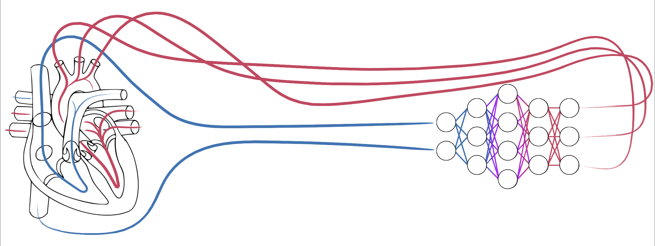








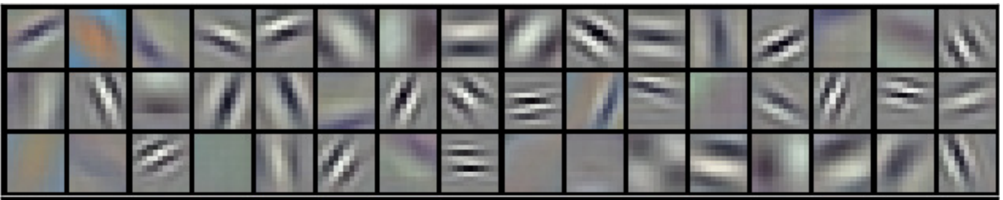
Header/Lab logo
Research Publications Members News Jobs Contact
Moving News box – eg “Toward a clearer picture of health -- Nature Medicine” an other news items currently on landing page
<
>
Improving the resolution and accuracy of cardiovascular phenotypes will lead to novel insights and therapies. This can occur by drilling down—understanding the genetic and cellular mechanism of a particular disease—or going broad, using computational means to analyze precision phenotypes at scale.
Dr. Arnaout is currently developing computational methods to bring precision phenotyping to medical imaging. Her background as a physician-scientist informs the future scope of this work as a technology that can transform non-invasive imaging into a big-data tool for both research and clinical use. She also uses animal and in vitro models to study cardiovascular gene function and to model human cardiovascular disease.

